Slide 1
Plant Origin
Plants evolved from green algae (protists)
They are first classified as
a) Nonvascular – short plants with no transport tissue (like veins), e.g. moss
b) Vascular – taller plants with veins, e.g. trees
i) Xylem – veins for water
ii) Phloem – veins for food

Slide 2
Vascular plants can further be classified as
Gymnosperms – cone bearing plants, e.g. pine trees
Angiosperms – flowering plants, e.g. roses
Anatomy: study of the structure of organisms… looking at cells, tissues
Morphology: Study of form
Physiology: study of the function of cells, tissues, organs of living things and
the physics/chemistry of these functions.

Slide 3
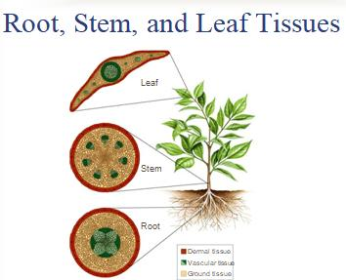

Slide 4
Root Functions and
Stem Functions
Root Functions
1. Anchors the plant
2. Absorbs water and minerals from soil
3. Stores food
Stem Functions
1. Connects the leaves with the roots
2. Displays the leaves for maximum sunlight exposure.
3. Stores food
4. Minor photosynthetic ability
5. Contains vascular tissue:
Phloem – transports sugars from leaves
Xylem – transports water and minerals from roots

Slide 5
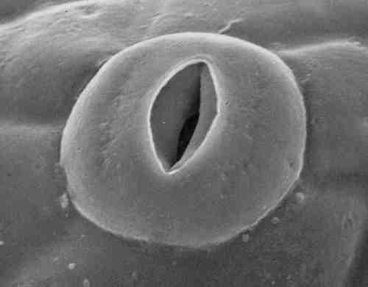
Leaf Functions
1.Carries on Photosynthesis
2. Stores food
3. Regulates transpiration through stomata

Slide 6
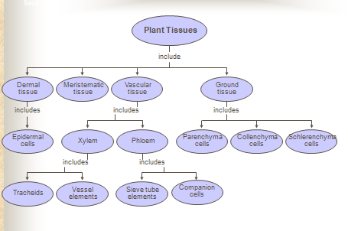
Classification of plant tissues

Slide 7
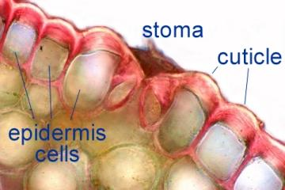
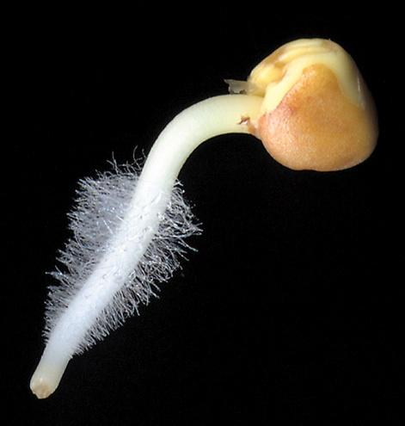
1-Dermal tissues
Is a thin layer of cells covering the soft parts of a plant. In stems and leaves,
epidermis has cuticle, a waxy layer that prevents water loss.
Root epidermis has root hairs, for water and nutrient absorption

Slide 8
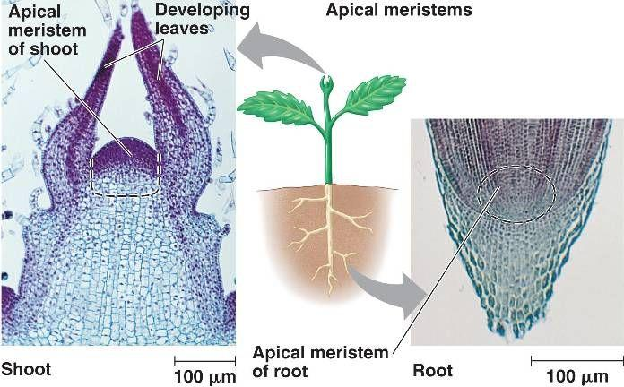
2-Meristematic tissues
Actively growing regions of plant.
Meristems consist of:
1. Primary meristems
2. Root apical meristems
3. Shoot apical meristems
Meristems regions:
1- cell division
2- cell elongation
3- cell differentiation

Slide 9
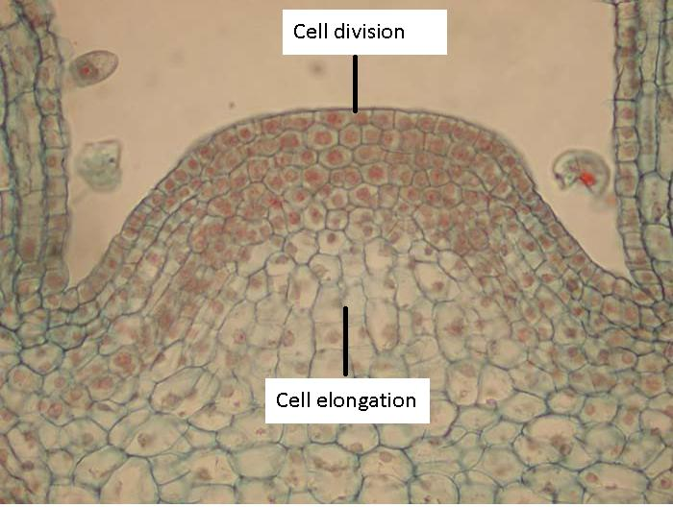

Slide 10
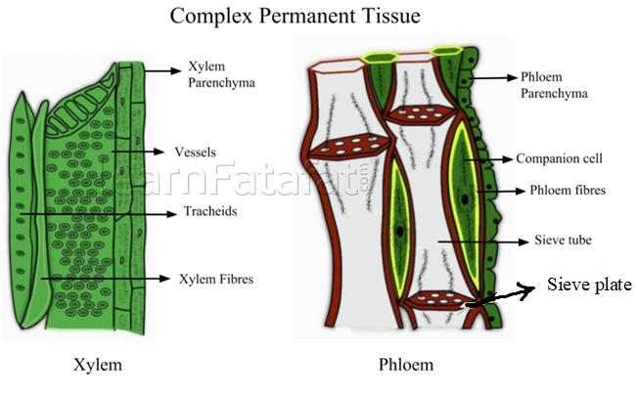
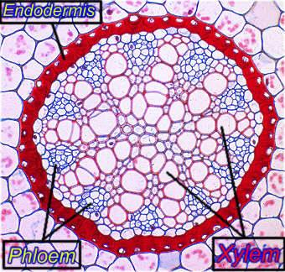
3-Vascular tissues: Is a complex conducting tissue, formed of more than one cell
Vascular cambium located in the middle of the vascular bundle, between xylem
and phloem

Slide 11
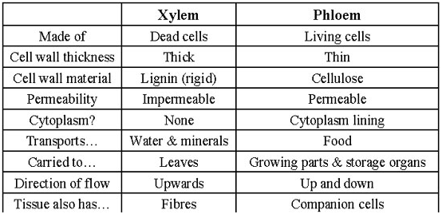
Comparisons between Xylem and Phloem

Slide 12
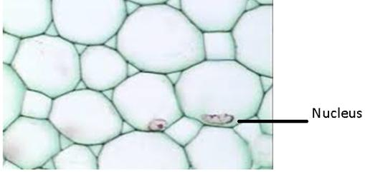
4-Ground tissue of plants includes all tissues that are neither dermal nor vascular.
It can be divided into three types based on the nature of the cell walls
A-Parenchyma cell
Parenchyma cells have thin, permeable primary walls enabling the transport of
small molecules between them, and their cytoplasm is responsible for a wide range
of biochemical functions such as nectar secretion.
These cells synthesize (by photosynthesis) and store organic products in the
plant. The soft tissue of fruits is also composed of parenchyma cells.
• Parenchyma cells are living cells that have functions ranging from storage and
support to photosynthesis.

Slide 13
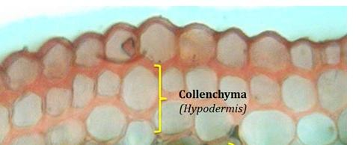
B- Collenchyma cells
Have a support function in plants, particularly in young plan
Collenchyma cells are alive at maturity and have only a prim
The wall is most commonly thickest at the corners.

Slide 14
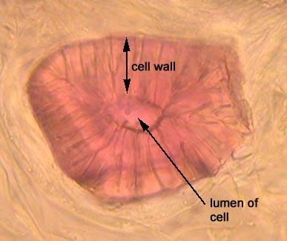
C-Sclerenchyma Cells
These cells are thick and contain various shapes.
Sclerenchyma cells form the hard outer shell of nuts and seeds. They are found in
stems, roots, and leaf vascular bundles. Sclerenchyma cells are typically dead at
functional maturity, and the cytoplasm is missing, leaving an empty central cavity.
Sclerenchyma cells also have a support function in plants.

